Slide 1

Volleyball Meeting 8/18/2019
Girls Volleyball

Slide 2
Pregame
Arrive 30 minutes before your assigned match
Use Google Maps, Maps on iPhone, MapQuest for accurate direction to the school
In case of traffic delays, have partner’s cell phone # on hand
Proper Uniform Attire
White Volleyball Certified Shirt, Black Pants or golf shorts, White Shoes and Socks or Black Shoes and socks
Equipment
Whistle, Cards (Yellow and Red), a coin (bigger than a nickel), net chain, flags and a watch

Slide 3

Pregame
Report to proper Court
B- teams play in the back gym • JV match in the main gym
Introductions
Partner, Scorer and Coaches
Checking of equipment
Ball air pressure should be 4.3-4.6 PSI ( if no ball on the scoring table ask home coach)
Net Height (Girls 7’4 1/8”, Boys 7’11 5/8”) Check Center of net and sides, allow for a quarter of an inch or less leeway
Padding of poles and Referee Stand, Fix Antennas if Needed
Benches on both side of court beyond the 3 meter line

Slide 4
Scorers
Linda Orr
Veteran Scorer for SNOA
NFHS & PAVO Certified Scorer
Mountain West Conference Scorer
***Expectations Scorers have for Referees and Referees expectations of Scorers

Slide 5
Coin Toss
R1 will whistle and hold up coin for the coin toss
Referee Positions
Ground Rules
Speaking captains are announced
Heads or Tails?
Who calls???
What are the choices for the winner?
Inform scorer
Who warms up 1st? 2nd? And how long
Do we talk to LJ’s
Check for Jewelry
SNOA warm up- 8 minutes/team

Slide 6
Unnecessary delays vs. Conduct yellow
a. Delay by a team not being immediately ready to start play when directed by the first referee;
b. Delay resulting from a substitute attempting to enter or when a player is in the set wearing illegal equipment/uniform;
c. Delay in resuming play due to a coach/captain making excessive requests for the serving order;
d. Delay by a team in properly completing a substitution(s) or a substitute(s) entering the court before authorization by the referee;
e. An illegal substitute attempting to enter the set;
f. An illegal replacement attempting to enter the set (illegal alignment once signal for serve is initiated);
g. A team repeatedly using an improper substitution procedure;
h. A coach does not make a decision about an injured player within 30 seconds (11-4-1);
i. Delay in returning to play after a time-out, or delay caused by cleaning up liquid or other substance used by a team(s) during a time-out;
j. Team conferring during a time-out at a location other than the team bench or court area;
k. A team requesting a time-out in a set after it has taken its allotted time-outs;
l. A libero entering the court outside the libero replacement zone;
m. Substitution is denied by the second referee after the request has been recognized (whistled) due to being illegal;
n. Improper request for a substitution, time-out or lineup check that is acknowledged (whistled) by the referee.

Slide 7
Unnecessary Delay
PENALTIES:
1. The first unnecessary delay by a coach, player, substitute, replacement or team results in a warning (administrative yellow card), but shall not result in a head coach being required to remain seated during play.
2. For any subsequent unnecessary delay during the same set by a coach, player, substitute, replacement or team results in an unnecessary delay penalty, (administrative) red card with a loss of rally/point awarded to opponent. The head coach is not required to remain seated during play.
NOTE: For repeated unnecessary delay violations in multiple sets, unsporting conduct may be issued by the first referee.

Slide 8
Scrimmages
Things we still need to work on
Any peculiar incidents that occurred
Jewelry
Coaches on the court
Upcoming scrimmages
How many scrimmages and meetings needed to become playoff eligible

Slide 9
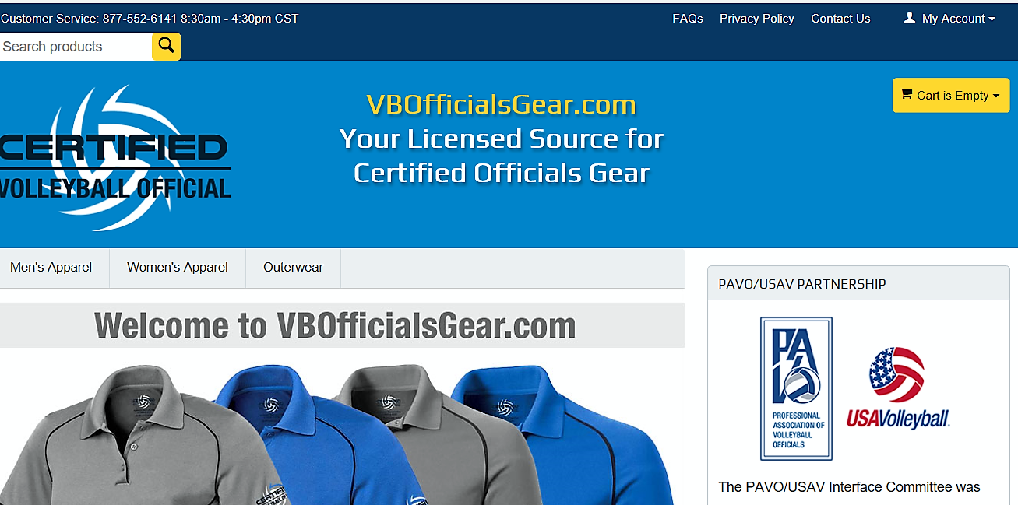
SNOA Volleyball Uniform
www.vbofficialsgear.com
White short sleeve shirt
Black slacks
Solid White shoes/White socks or
Solid Black shoe

