Slide 1

SNOA 2018 Boy’s
Volleyball Season

Slide 2
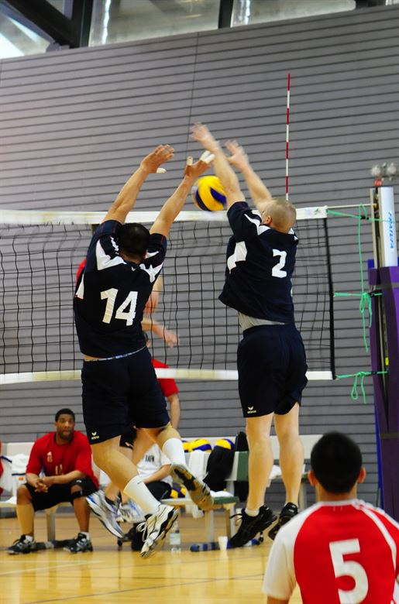
B.L.A.S.T.
B-back row attack
L-libero action
A-antenna
S-speed
T-touch

Slide 3
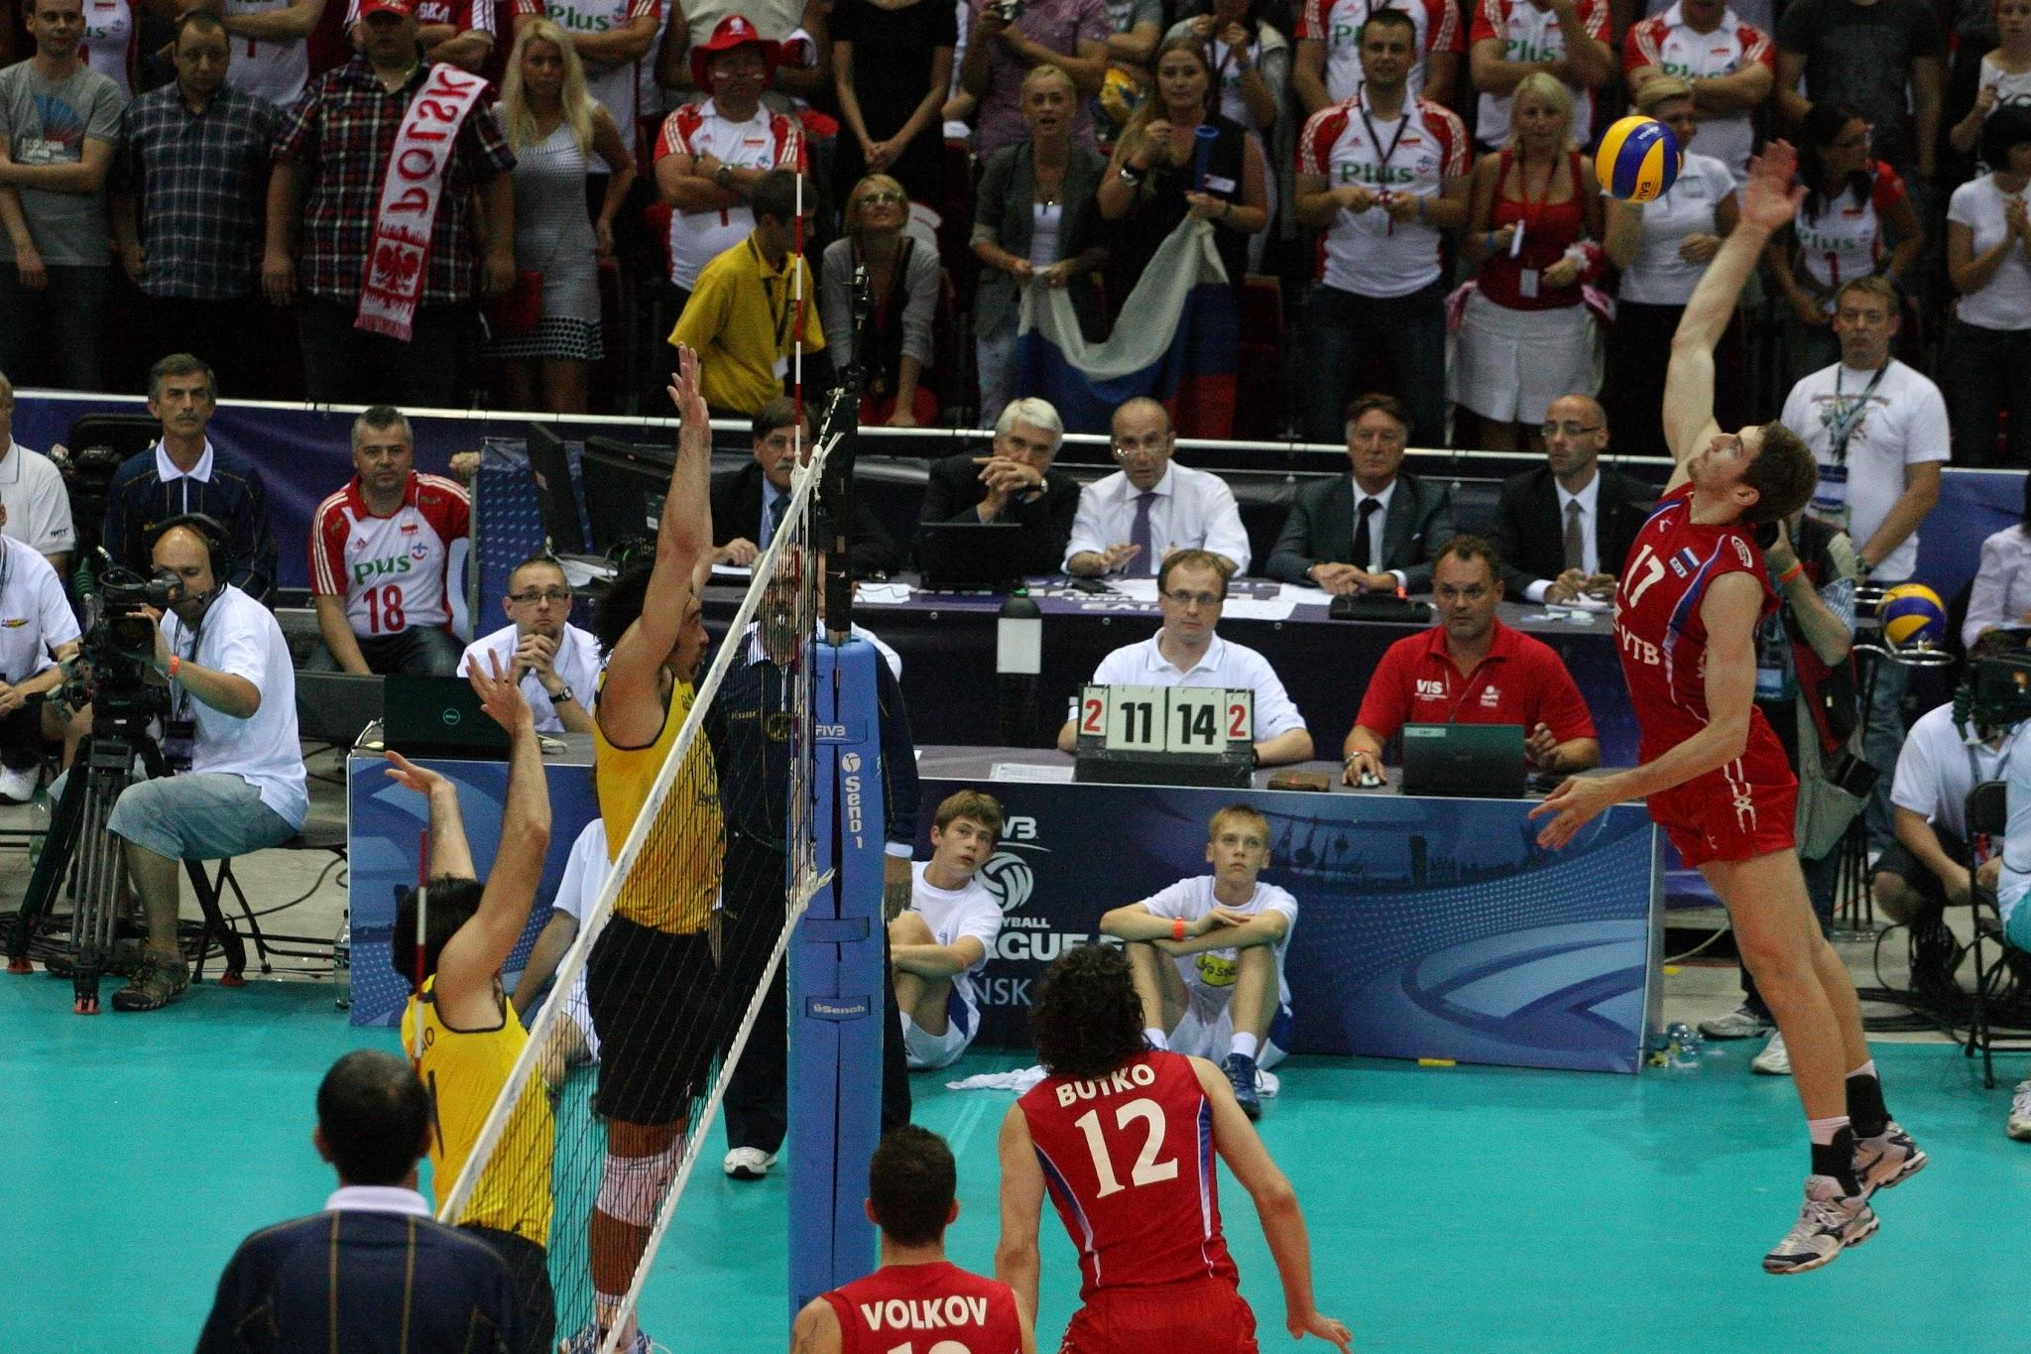
B (Back Row Attack)
When performing as the R2, we will assist the R1 with the Back Row Attack, starting with getting to the blockers side of the net, with eyes on feet of launch, and helping if possible the height of the ball at contact from hitter. Also we need to know the rotations for the case of who is in the front row. We have to know where the setter is (e.g. setters live, front row, rotations 4, 5, 6) in the situations of a joust or blocker trying to block the setters play before or after the finger action. You need to be aware when the setter is setting back row. You cannot be staring at the net.

Slide 4
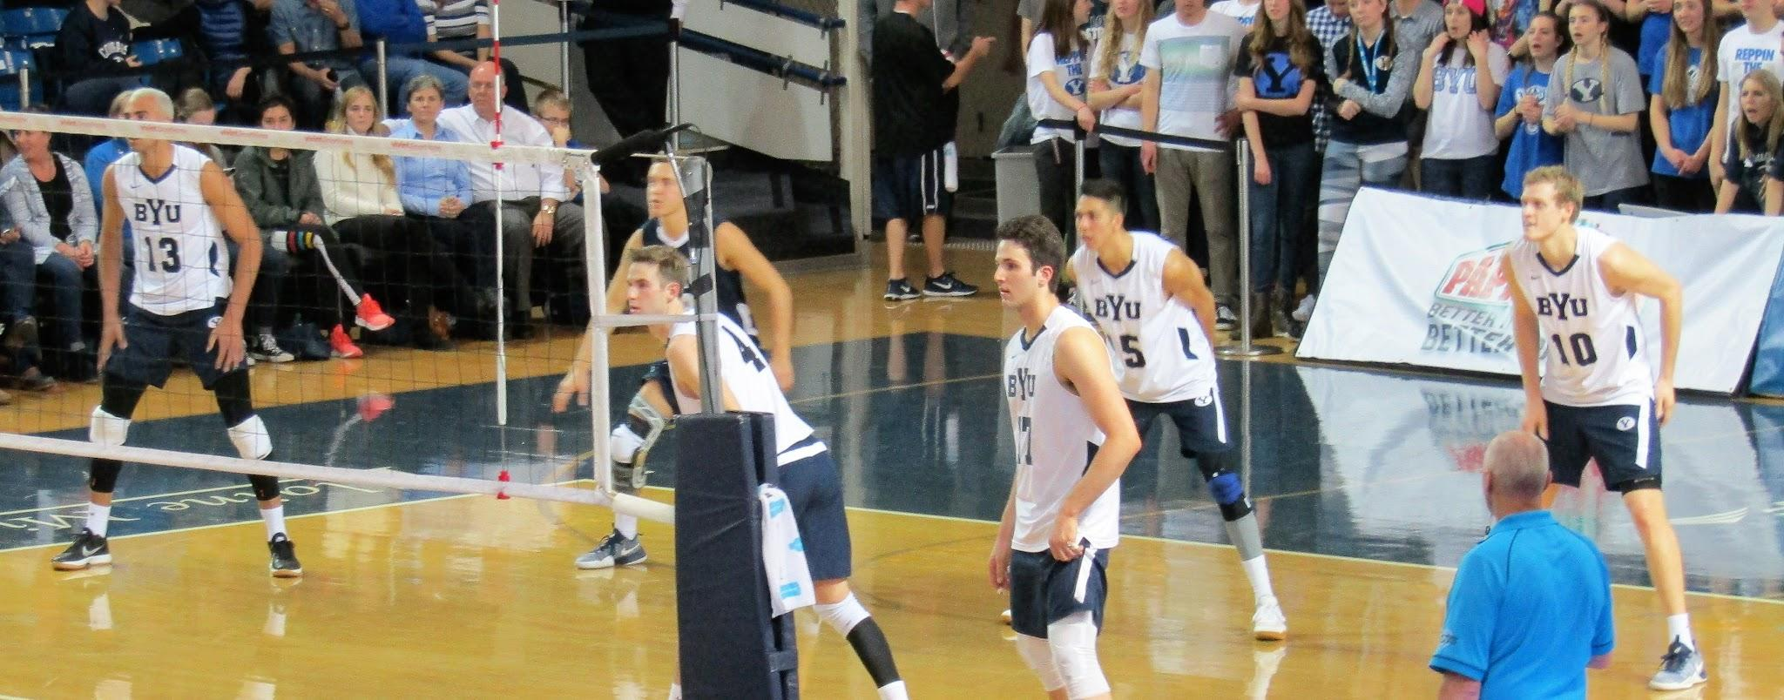
L (Libero Actions)
• You must assist the R1 if the Libero has feet on or in front of the attack line with finger action to any hitter completing an attack from above the height of the net. Libero serving and exchanging on and off the court. Tell your scorer about the triangle. Interact with your libero tracker as well as your scorer. Both officials also checking the libero jersey before the match starts if they are contrasting. Don't have the other team complain a few plays in that the others teams jersey is illegal. Plus we have the multicolored versus solid colored jersey still in NFHS.

Slide 5
A (Antennae)
• The hitter attacking right in front of you and the ball hit the A~, did the attacker hit the ball into the A~ then blockers hands, or vice versa. The ball is on your side of the court, you must prepare for quick thinking and use of the lines persons to sell your call or overrule. How will you communicate to your partner what information you have? Did the attacker hit the ball outside the A~ and you missed blowing the play dead? Did the blocker touch the A~ with his blocking action and you think it was the ball? If needed, please have both your lines judges come to the R1 stand. They can help, and it gives the impression of getting the call right, and not excluding the one who you overrule.

Slide 6
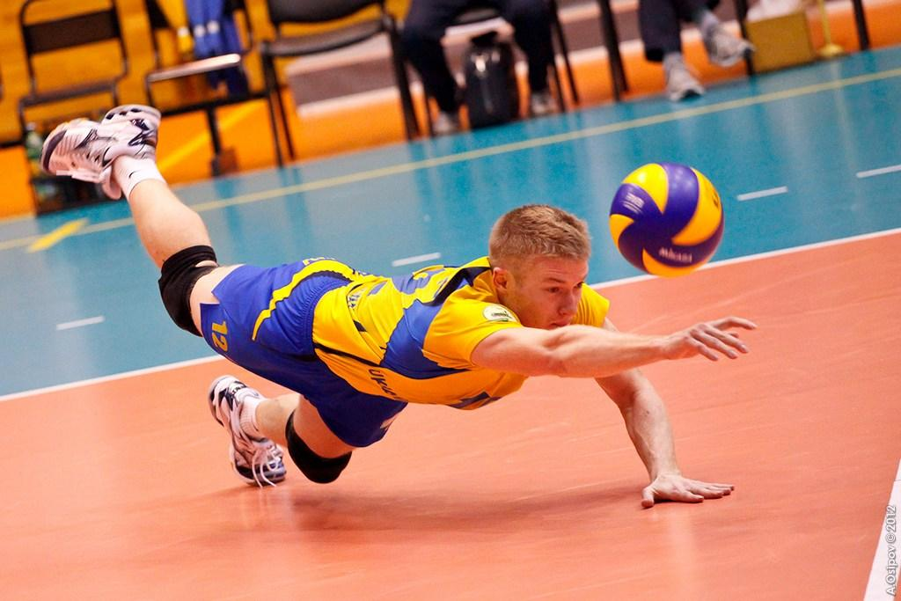
S (Speed)
•The game is going to be faster and the first couple of plays your eyes need to get adjusted. Of course the bang bang plays. If you just worked as the up official lower level, do not track the ball. stay on the net longer. Wait until the players leave the centerline before you try to transition. Sell your call, but do not be overzealous trying to display to everyone you have the call. Relaxed atmosphere is best. Keep your eyes on the net and centerline longer than you think because the hitter will be predominantly near the centerline. Blockers and setters releasing will be there and feet will encroach. Prepare with your eyes, not your whistle. Don't cause an unnecessary replay for the benefit of the wrong team.

Slide 7
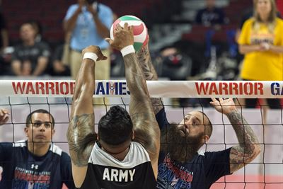
T (Touch)
The crucial part of the game where we have four sets of eyes on the court, different angles for the crew can see and call the touch on the blocker primarily. And now the lines people have to call the touch on the back row players with digging plays where you will be obstructed by other players. This will set the officials apart along with the judgments on setting where the coaches feel the most confident (or unconfident) in the officials and their abilities.
The R2 and R1 have to Center and communicate the touch was seen or their was one undetected by the crew. The coaches cannot have a long drawn out discussion or argument about this play. We have to move ahead with the match.

Slide 8
Added Necessities for Better Flow
Centering Philosophy- Please both officials must CENTER with their eyes after every play. As soon as the play is dead, look at your partner and make the signal mechanics, and have your eyes ready to see the interaction of the players after the play is over to look for unnecessary talk through the net. Trash talking is not acceptable and you must be ready to step in and stop it immediately. Cards are in the officials discretion, but I would like to see more warnings and yellow cards if they are required. Do not be too nice, because the next match the same player or coach will try even more.
Be prepared for short, distinct discussions with the coach the differences if you can help get the game resumed. Let me reiterate, some coaches know what the rules are, but may be delaying the game on purpose to ice the next server on the opponents team by having a long discussion with the R2. You must be prepared to talk the rulebook, nothing else.

Slide 9
Professionalism
Please handle yourself in the most Professional manner in relating to the players, coaches, fellow crew working with you, the school administrators and whoever else sees you in a white shirt. We are all being watched in countless means of media. Assume you are getting rated on every match.
Enjoy the season and enjoy working with your partners.

